Slide 1




Now That You Are a Data Scientist, What Next?
An Analytical Summary for the job of a Data Scientist/Analyst by average salary, job title, skills required, and industry/sector .
An Industry report compiled by:
<L><A><J>
(Lien Lai, Abi Akinlotan, Jennifer Carden)

Slide 2
Who is a Data Scientist?
O’Neil, C., and Schutt, R. Doing Data Science
“More generally, a data scientist is someone who knows how to extract meaning from and interpret data, which requires both tools and methods from statistics and machine learning, as well as being human. She spends a lot of time in the process of collecting, cleaning, and munging data, because data is never clean.”
Shashi Upadhyay, CEO of Lattice
“Data Scientists are referred to as ‘UNICORNS’. They are professionals with a diverse skillset that is not commonly found in a single individual”

Slide 3


Jennifer Carden
Married with three kids.
All girls! Ages 8 (twins) and 17 months.
From Panama City FL but moved to Fargo ND last year.
I love a challenge and strive to apply 110% in everything I do.

Slide 4


Lien Lai
Married with three kids.
All Girls! Oldest is 18 yrs. old, middle is 16; and youngest is 9.
My sister and niece (who is 10 yrs old) live with us.
We do everything together.
I have a BA in Arts.
I’ve been working with children for the past 18 years.

Slide 5

Abi Akinlotan
First of 3 sisters, we are close-knit and very protective of each other.
I have a BSc in Microbiology.
Over the years I have deployed data insights to marketing strategies and to building business solutions.
I currently work in the Healthcare Sector but secretly wish I was either coding or growing a startup.

Slide 6



Project Background
As fresh graduates and women with similar backgrounds we were curious to explore the Job industry with regards to what was obtainable. We eagerly explored data sets and found this off Kaggle:
Our meeting was the beginning of a new relationship and a bigger opportunity to learn from each other while leveraging on our newly acquired skills.
Visualized data distribution in Tableau, wrangled in Python and R to predict models and run analyses to show that at least one variable has measurable predictive values for the purpose of gathering industry insight.
The data set contains the following variables:
Average Salary
Ratings
Job Titles
Industry
Sector
Age of Company e.t.c
https://www.kaggle.com/nikhilbhathi/data-scientist-salary-us-glassdoor?select=data_cleaned_2021.csv

Slide 7
Methods
Linear Regression
Stepwise Regression
Pearson’s Correlation Coefficient
ANCOVAS
ANOVA
Independent t-tests
Descriptive Statistics

Slide 8




Results
We ran test assumptions in R :
Did skills influence the location
Did the age influence the salary
Were there outliers
Did the sector depend on where the location is
Did an ANCOVA on job skills
Made Visuals to show our assumptions and more information in Tableau:
Maps
Box Plots
Heatmaps
Bubble Graphs
Made Visuals in Excel:
Pie graph of value count – Sector
Pie graph of percent of Job Titles
We ran correlations in Python:
Found value count of columns
Found means of Job Titles by salary
Found if there were any correlations between the data
Looked at Pair Plots for linearity
Ran Anova test between the means of job skills
Found the percentage of Job titles

Slide 9
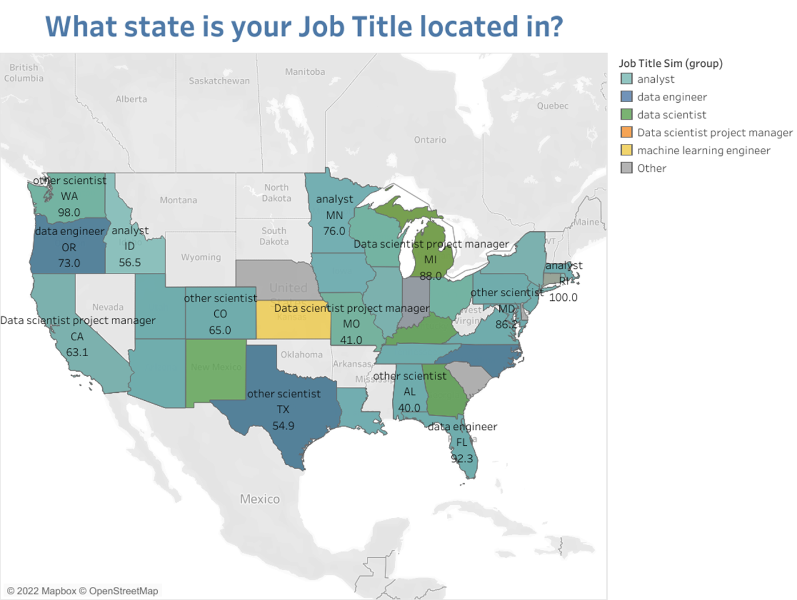
Highlight Job title 2

Slide 10
File created on: 4/13/2022 2:08:02 AM

Slide 11
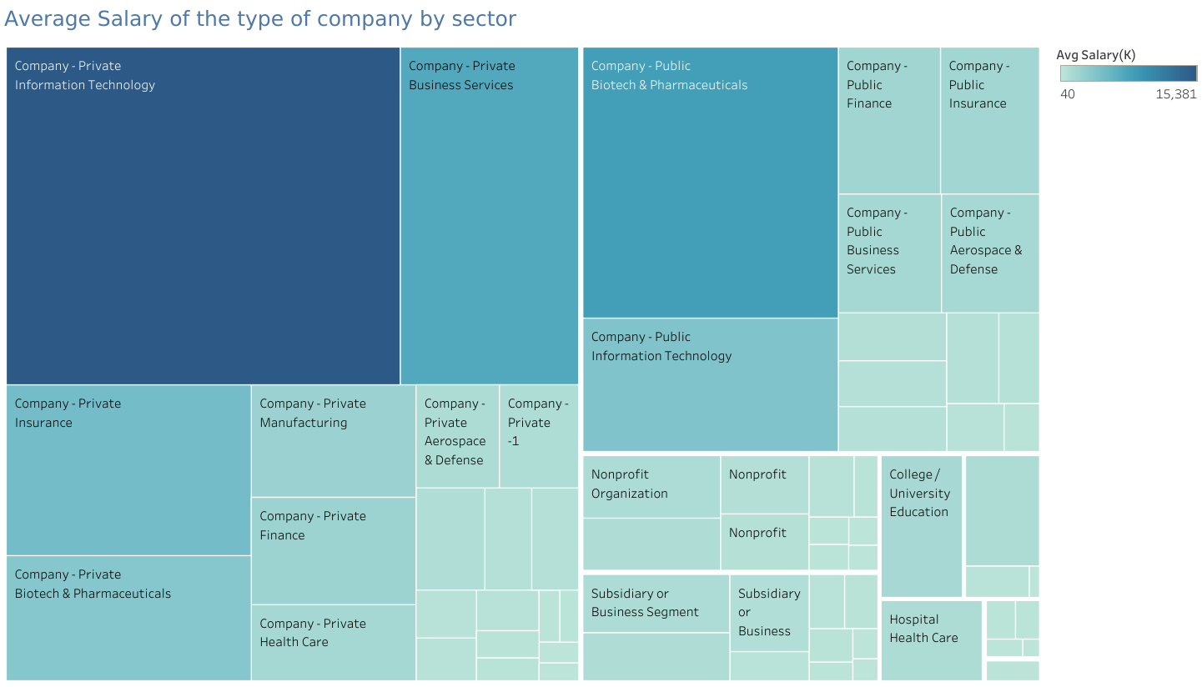
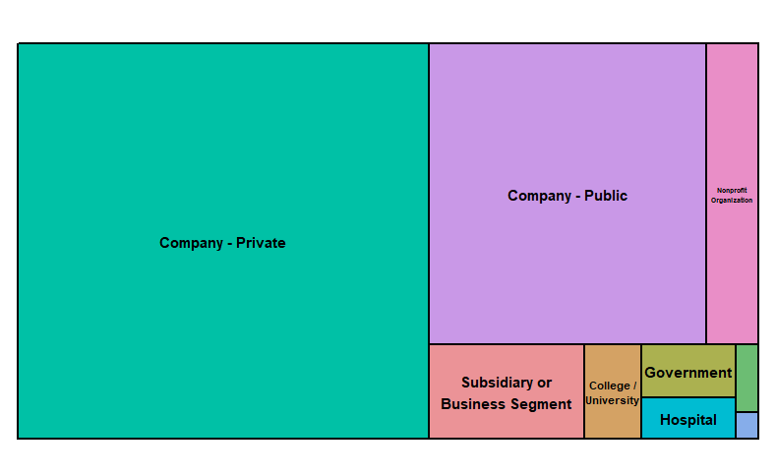
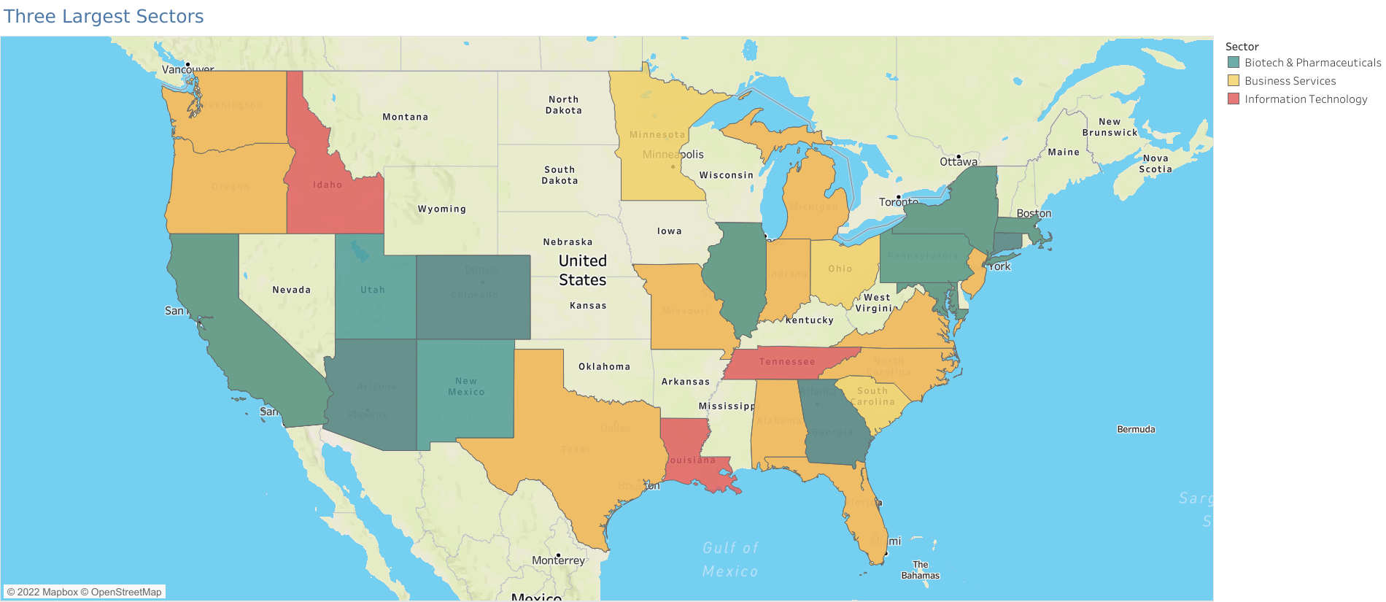
Which type of Company pays the most?
Where are the top three types located?

Slide 13

The top five (5) companies with the most job openings:
MassMutual is an insurance company in Spring Field, Massachusetts that also provides retirement, college and home budgeting plans.
Reynolds American is a Research Tobacco company in Winston-Salem, NC. They are a subsidy company to the British American Tobacco PLC and parent owners of Newport, Camel, Snus etc.
Takeda Pharmaceuticals is a Japanese company that has world-wide offices in US, Europe, and Canada. The US company is located in Lexington, MA where they research on oncology, rare diseases, neuroscience, gastroenterology, plasma-derived therapies and vaccines.
Software Engineering Institute is a research and development center sponsored by the US Dept. of Defense in Pittsburg, PA. SEI has delivered innovative methods, tools, algorithms, and frameworks to meet current software and cybersecurity needs and provide a foundation for combating future ones.
PNNL is a research facility in Washington State. PNNL’s core capabilities are organized into five areas:
Chemical and Materials Sciences
Computational and Mathematical Sciences
Earth and Biological Sciences
Engineering, and
User Facilities and Advanced Instrumentation.

Slide 14
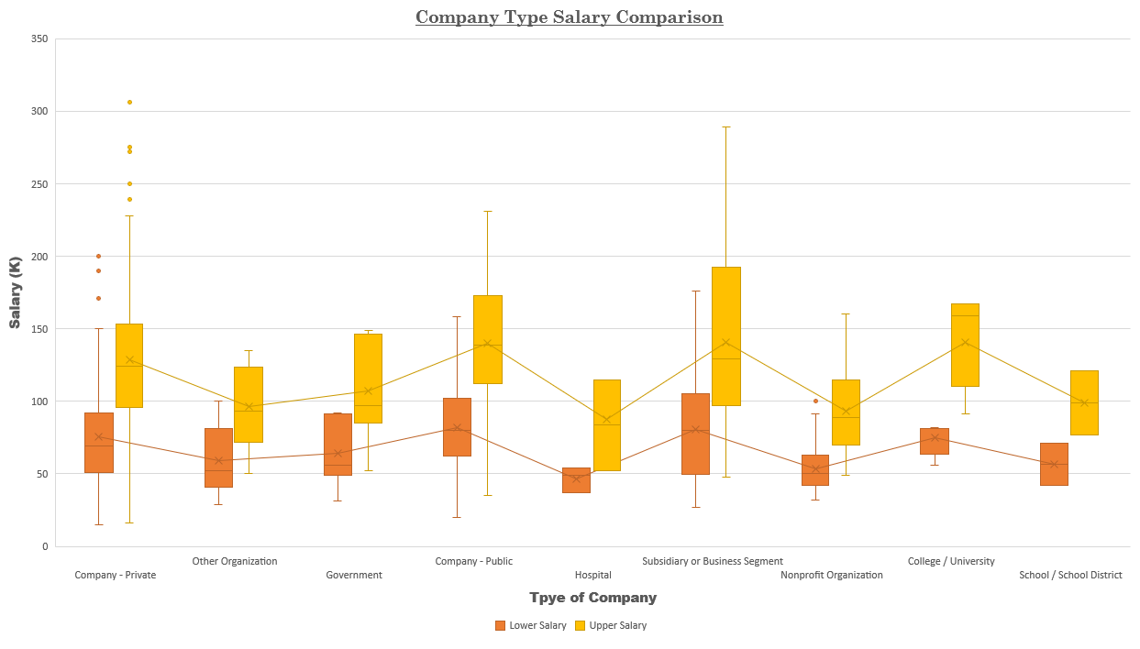

Slide 15
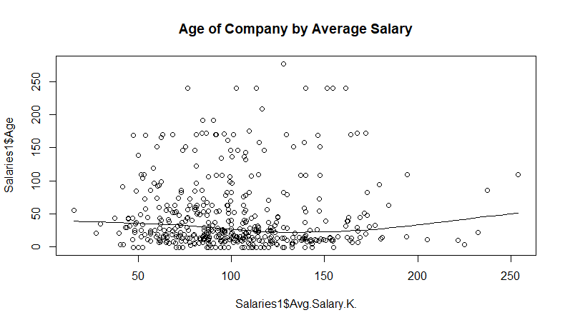
Assumptions for Linearity not met

Slide 16
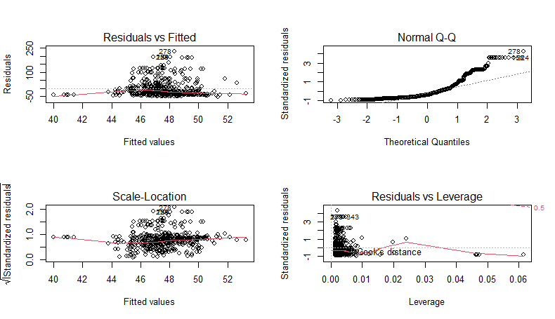
Was the interpretation true??

Slide 17
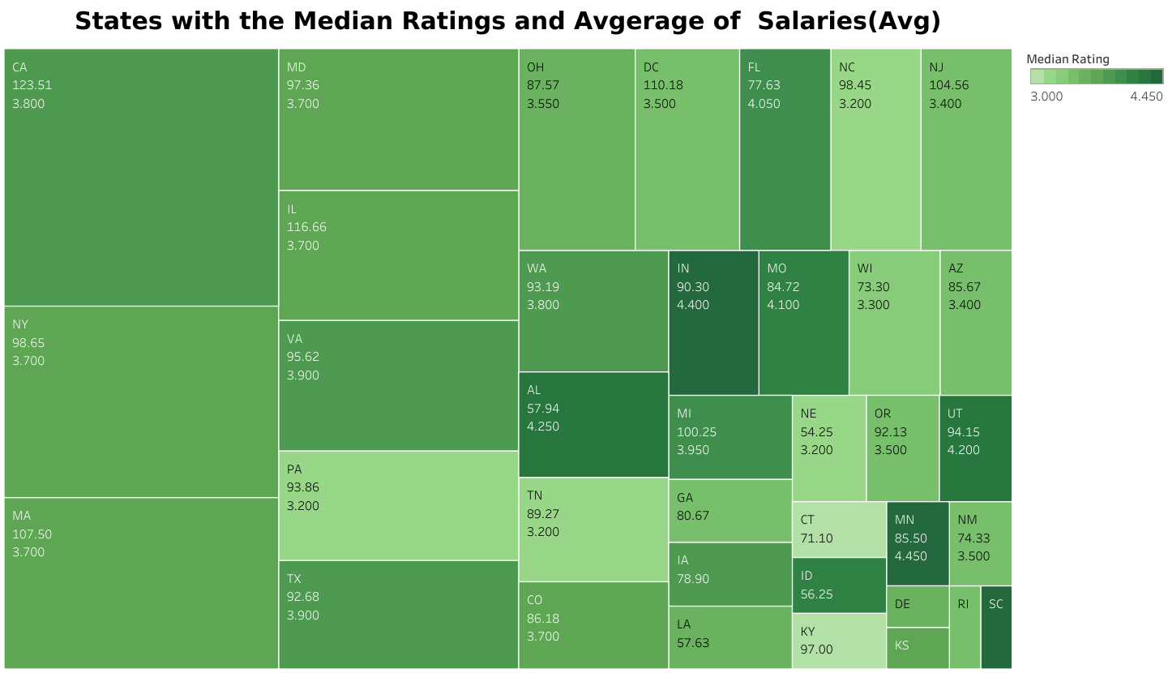
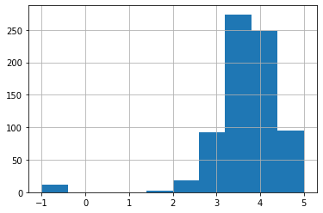
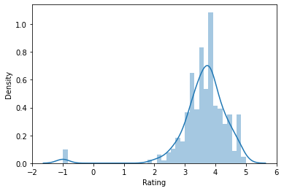
Majority of the companies have a rating between a 3 and 4.

Slide 18

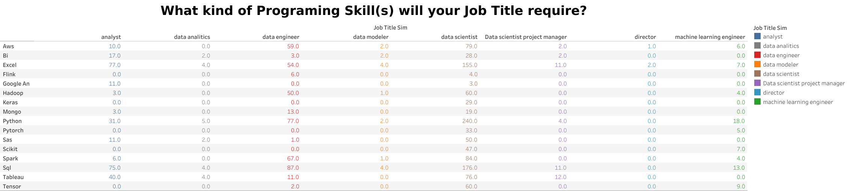
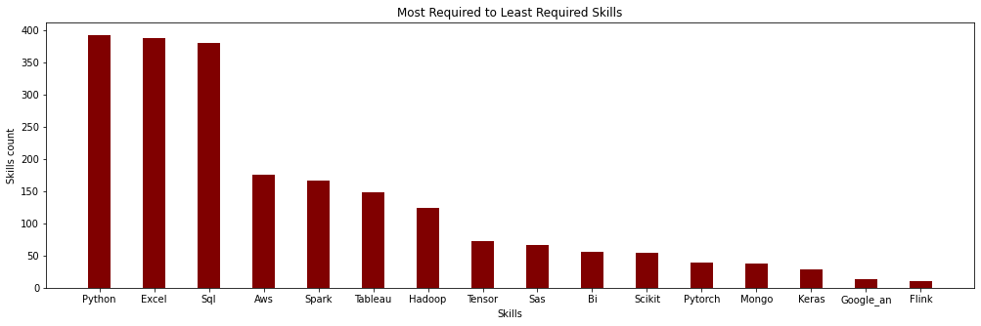

Slide 19

Call:
lm(formula = NewSector ~ spark + aws + tensor + bi + mongo +
google_an, data = bindSalaries)
Coefficients:
(Intercept) spark aws tensor bi mongo google_an
5.049 -1.677 -1.091 1.486 1.201 3.634 7.819
Call:
lm(formula = NewSector ~ spark + aws + tensor + bi + mongo +
google_an, data = bindSalaries)
Residuals:
Min 1Q Median 3Q Max
-9.868 -3.049 -1.049 1.951 21.628
Coefficients:
Estimate Std. Error t value Pr(>|t|)
(Intercept) 5.0488 0.2104 23.994 < 2e-16 ***
spark -1.6768 0.4324 -3.878 0.000115 ***
aws -1.0909 0.4105 -2.658 0.008042 **
tensor 1.4865 0.5765 2.579 0.010114 *
bi 1.2013 0.6263 1.918 0.055489 .
mongo 3.6342 0.7846 4.632 4.29e-06 ***
google_an 7.8193 1.2132 6.445 2.10e-10 ***
---
Signif. codes: 0 ‘***’ 0.001 ‘**’ 0.01 ‘*’ 0.05 ‘.’ 0.1 ‘ ’ 1
Residual standard error: 4.475 on 731 degrees of freedom
(4 observations deleted due to missingness)
Multiple R-squared: 0.1135, Adjusted R-squared: 0.1062
F-statistic: 15.6 on 6 and 731 DF, p-value: < 2.2e-16
Make it or Break it
Which of the job skill would make a difference in the analysis we make? What are the Predictors

Slide 20
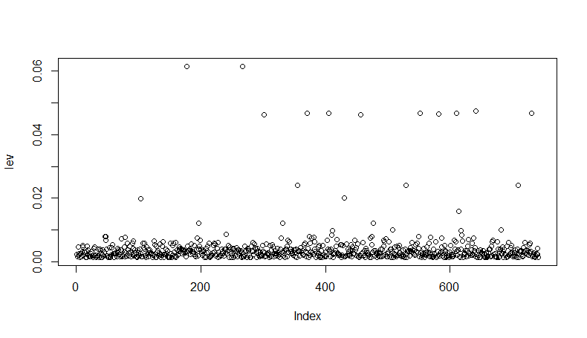

Slide 21
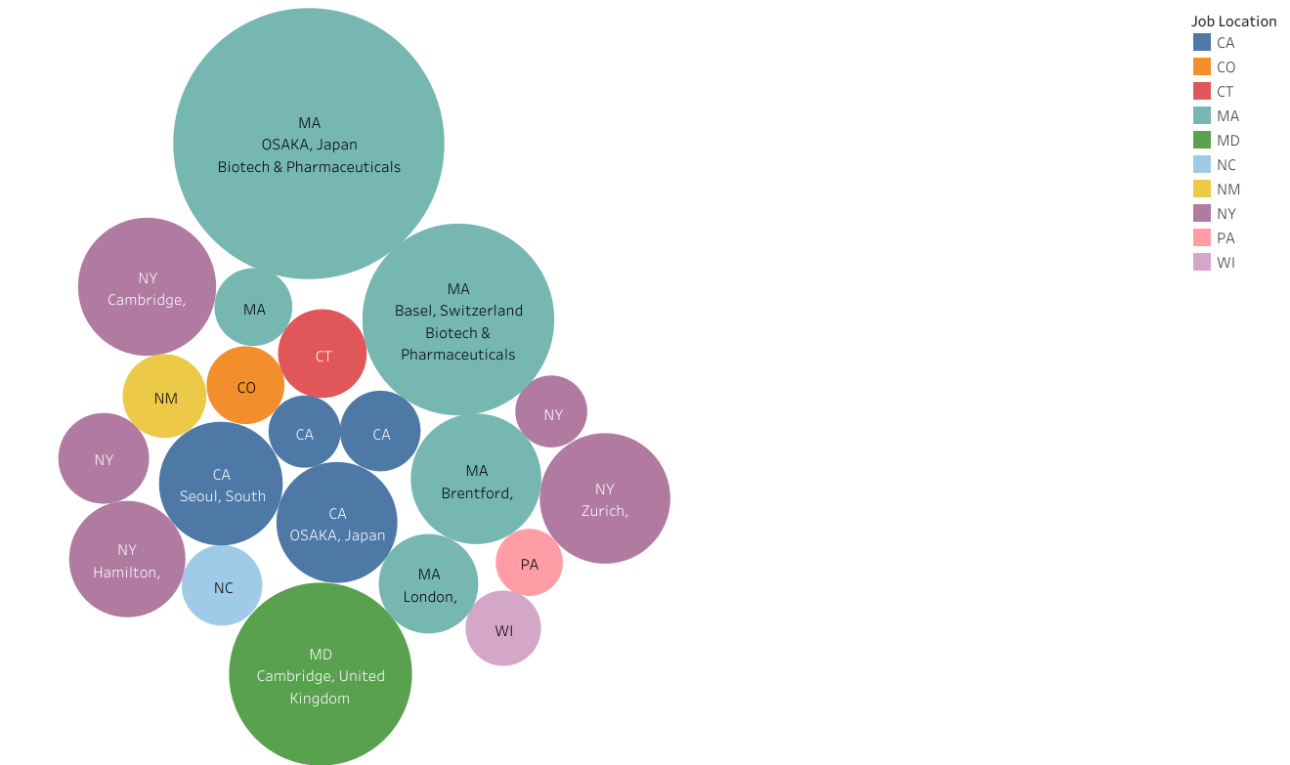

Bubble graph
Not All Companies are in the US

Slide 22
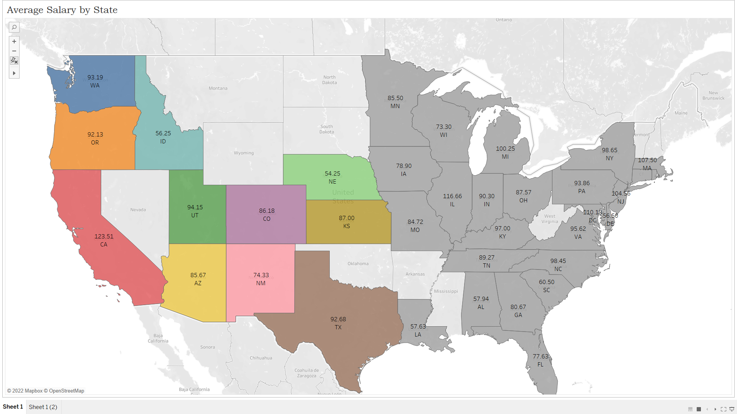
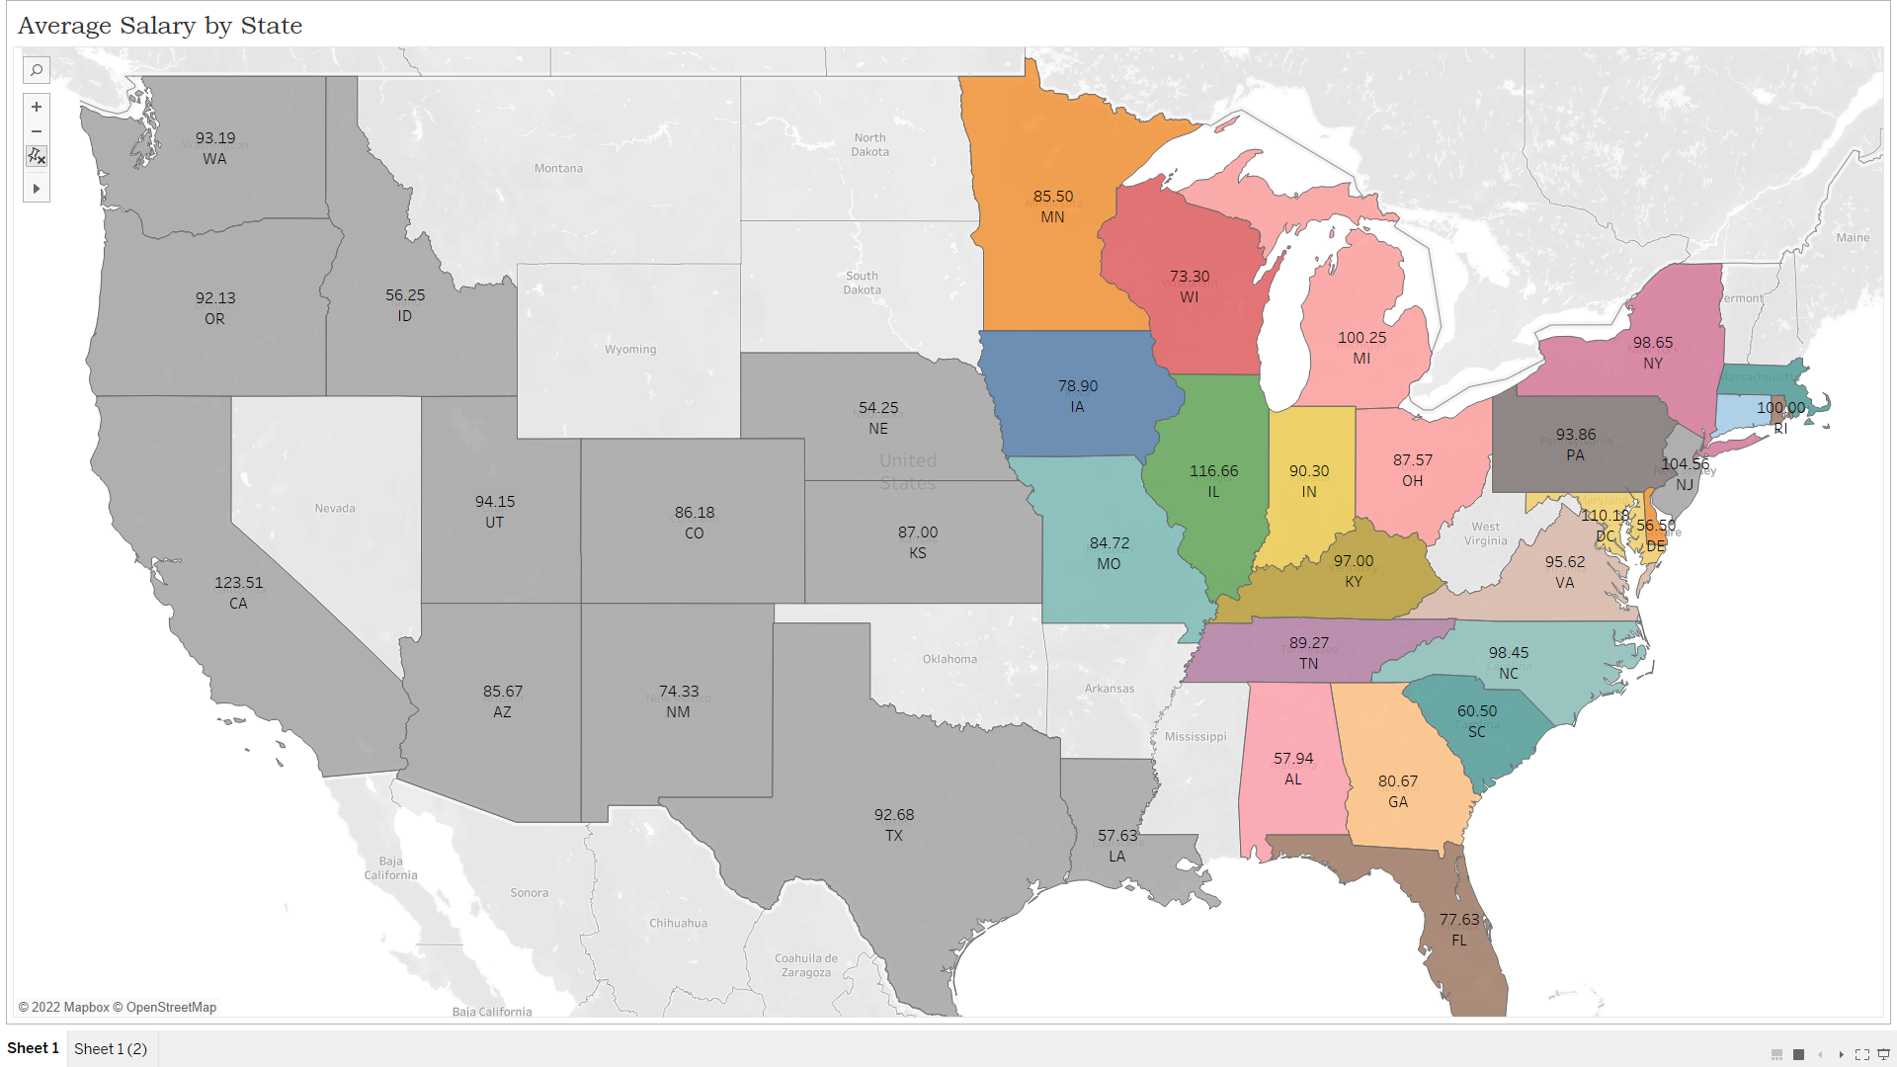
Working on the West Coast Vs. East Coast
West Coast Salaries
East Coast Salaries

Slide 23
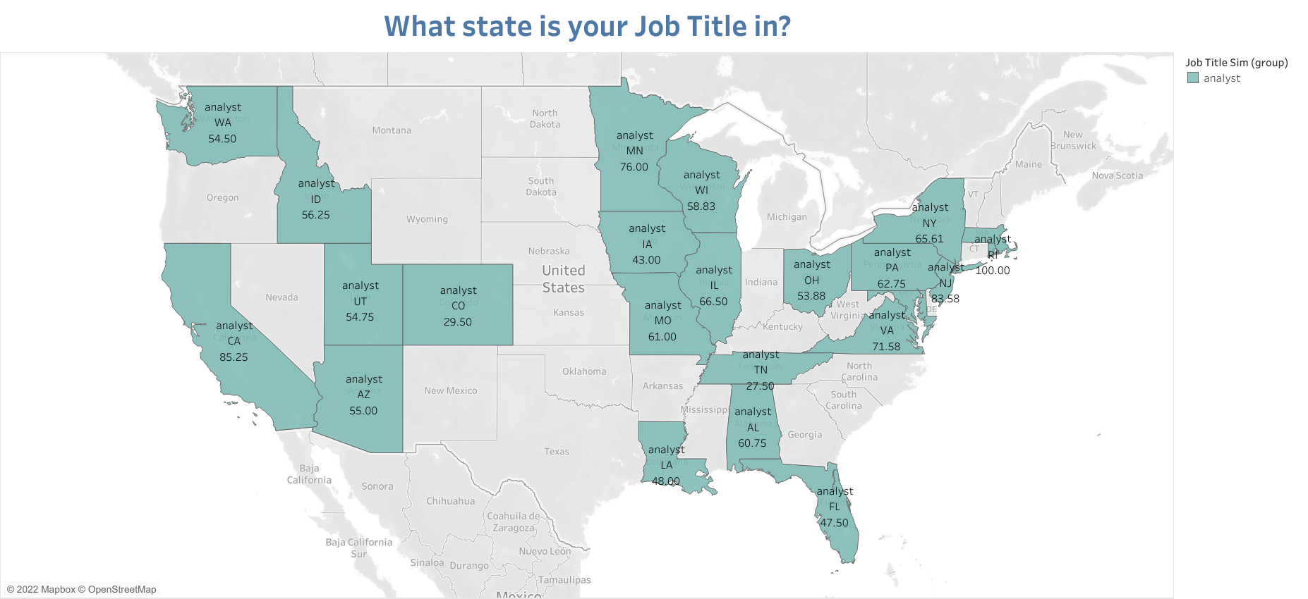
How much could a Data Analyst
make?

Slide 24
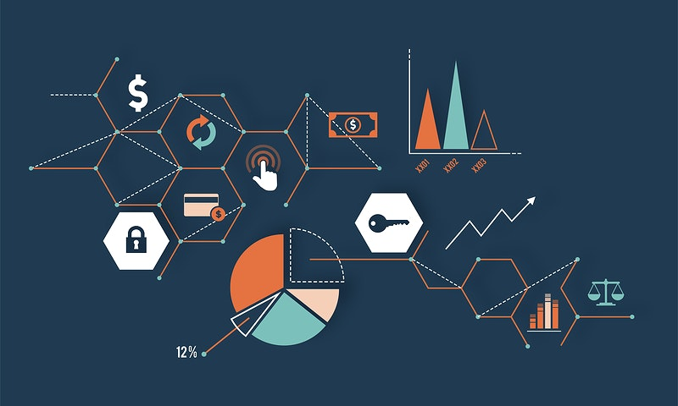
Conclusion

Slide 25

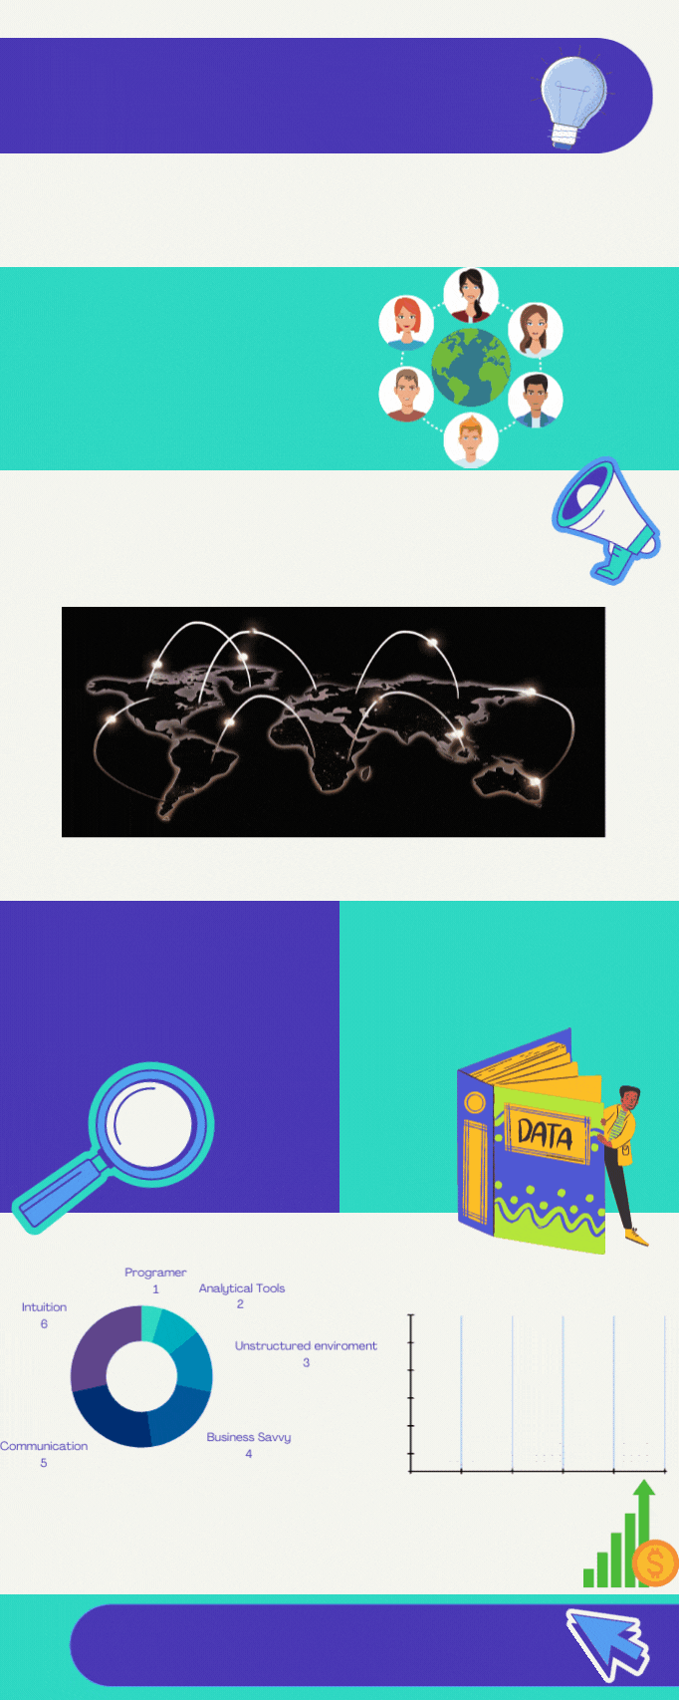
Questions

